Slide 1

University Of St. Thomas
SEIS 764 : Artificial Intelligence
Project Title : Face Recognition
Professor: Dr. Chih Lai
Team Member:
Duyen Su
Mugdha Dixit
Priyanka Patil
Pragya Verma
Yeeyin Lim

Slide 2
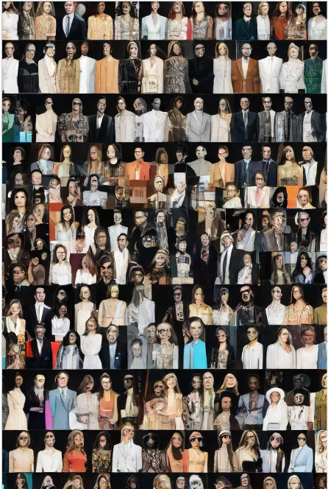
Overview
Exploring Facial Recognition
Aims to address real-world applications like security and surveillance.
Serves as a platform for exploration and innovation in computer vision and deep learning.
Potential societal impacts and educational benefits are also considered.
Development of accurate and efficient facial recognition systems using advanced CNN algorithms drives the project.
Notes:
The project is driven by the need to develop accurate and efficient facial recognition systems using advanced CNN algorithms, aiming to address real-world applications such as security and surveillance. Additionally, it serves as a platform to explore and innovate within the realm of computer vision and deep learning, with potential societal impacts and educational benefits

Slide 3
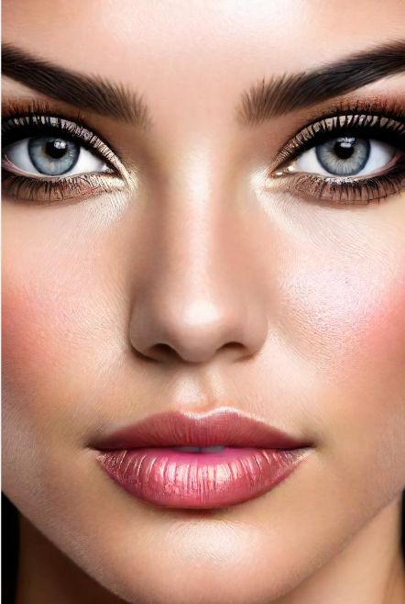
Understanding Dataset
Labeled Faces in the Wild (LFW)Dataset.
Data Sourcing : University of Massachussetts
Data URL : https://vis-www.cs.umass.edu/lfw/#download
Notes:
Describe the types of data present in the dataset, such as facial images of celebrities, and any additional metadata like names or labels associated with the images.
Discuss the overall size of the dataset, including the number of images and unique celebrities present, providing a sense of its scale and complexity.
Touch upon the quality of the images, mentioning factors like resolution, clarity, and any preprocessing steps applied to enhance image quality.
You can mention any challenges or limitations associated with the dataset, such as class imbalance or data inconsistencies, which may impact subsequent analysis and modeling.

Slide 4

Data Mining
﻿
Defining the Business Problem
Exploring Data Understanding
Preparing the Data
Implementing Model
Model Evaluation
Notes:
Explanation:
Defining the Business Problem: The initial phase involves a thorough comprehension of the problem description, outlining crucial questions that need resolution.
Exploring Data Understanding: Comprehensive univariate and bivariate analyses are conducted to unravel relationships between dependent and independent variables, providing a profound insight into the dataset.
Preparing the Data: This stage involves readying the dataset for data mining techniques. Conventional pre-processing methods, including variable transformation, data splitting, and cleaning, are applied to ensure optimal usability.
Implementing Models: Data mining techniques are employed to predict insurance charges for each patient. Multiple algorithms are executed, evaluated, and compared to identify the most effective model.
Model Evaluation: The final stage rigorously assesses and compares each model using a test set. The selection criterion is based on performance metrics such as RMSE (Root Mean Square Error) and Adjusted R-Square, ensuring the identification of the most robust model.

Slide 5
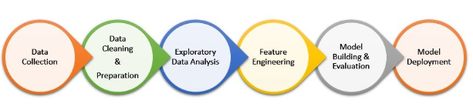
Data Description
Dataset volume: 8 MB
13,233 images of celebrity faces. There are 5749 unique celebrities in the entire data set and 1680 are represented by multiple images and
The dataset is designed for exploring, creating and testing image recognition algorithms.

Slide 6
Data Statistics
List of all the names in the dataset along with the with the number of available images for each name.
Image pairs featuring the same individual.
Image pairs featuring different individuals.

Slide 7

Exploratory Data Analysis (EDA)
2. Exploratory Data Analysis (EDA)
Understanding Data Structure:
Crucial to comprehend how the data is organized.
Utilized exploratory code to analyze the structure and characteristics of the data.
Leveraged information provided in the LDW dataset
Dataset Division:
We divided the dataset into Training and Testing
Training : 862 unique values individuals
Testing : 846 individuals
Included Columns:
Essential columns incorporated in both the training and testing subsets.
Notes:
1 Using data exploration and summary technique we are finding number of unique celebrities, the count of celebrities with multiple images, and the total number of images available. Additionally, it identifies the most represented celebrity and the number of unique images they have in the dataset.
2. Performing data reshaping involves restructuring the dataset to a format suitable for machine learning, while data splitting divides it into subsets for training and testing, ensuring model accuracy and generalization.
3. Examining the format and quality of images involves assessing factors such as resolution, color depth, and clarity to ensure consistency and suitability for analysis and model training in image-based tasks like computer vision or facial recognition.
4. Analyzing class imbalance involves identifying unequal distribution of classes in a dataset, which can affect model performance and require techniques like resampling or weighting to address.
5. Conducting sanity checks involves verifying the correctness, integrity, and coherence of data or processes to ensure they align with expectations or standards. In the context of the provided code snippet, conducting sanity checks likely involves validating the dataset's connections and image accessibility to confirm their accuracy and suitability for further analysis or modeling tasks.

Slide 8
Exploratory Data Analysis (EDA)
The data set is highly imbalance. To treat that we used binary classification.
For example, The most represented celebrity is George_W_Bush, with 530 unique images in the dataset. We classified them as A or B.
Celebrity Name | Number of Images
George_W_Bush | 530
Colin_Powell | 236
Tony Blair | 144
Donald_Rumsfeld | 121
Gerhard_Schroeder | 109
Ariel_Sharon | 77

Slide 9
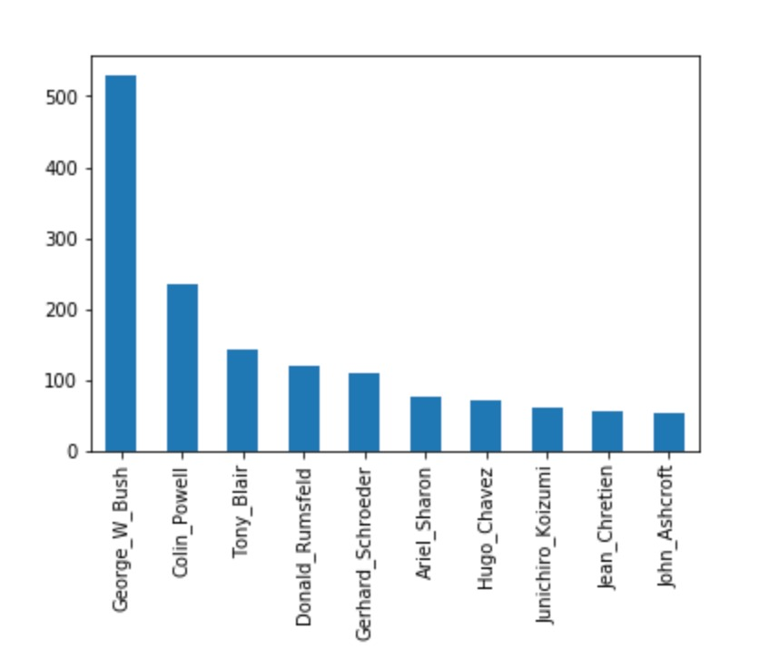
Exploratory Data Analysis (EDA) Top 10 people who had most images in data
2. Exploratory Data Analysis (EDA)

Slide 10
Evaluation Metric Decision
Evaluation Metric Decision:
Selecting a specific metric to evaluate the performance.
Helps us understand how well the algorithm is working.
Consideration of Dataset Characteristics:
Evaluating the characteristics of our dataset.
Determining which metrics are most suitable based on dataset characteristics.

Slide 11
Evaluation Metric Decision
Precision:
Measures the accuracy of face detection by evaluating the proportion of correctly identified faces out of all positive detections.
Interpretation: A high precision value indicates a low rate of false positives, ensuring that identified faces are likely to be genuine.
Recall:
Assesses the comprehensiveness of face detection
Interpretation: A high recall value indicates that the algorithm can detect a large proportion of the faces present in the dataset, minimizing the risk of overlooking any.

Slide 12
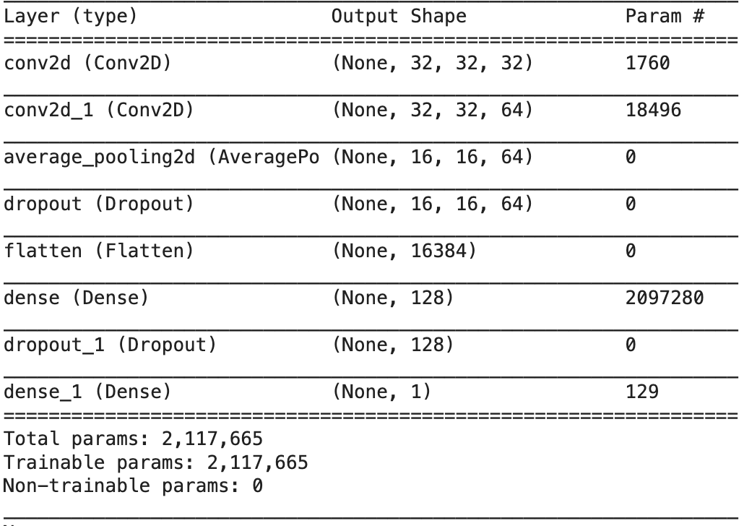
Classifying Faces: Baseline CNN Model 1 epochs = 25 batch_size = 128

Slide 13
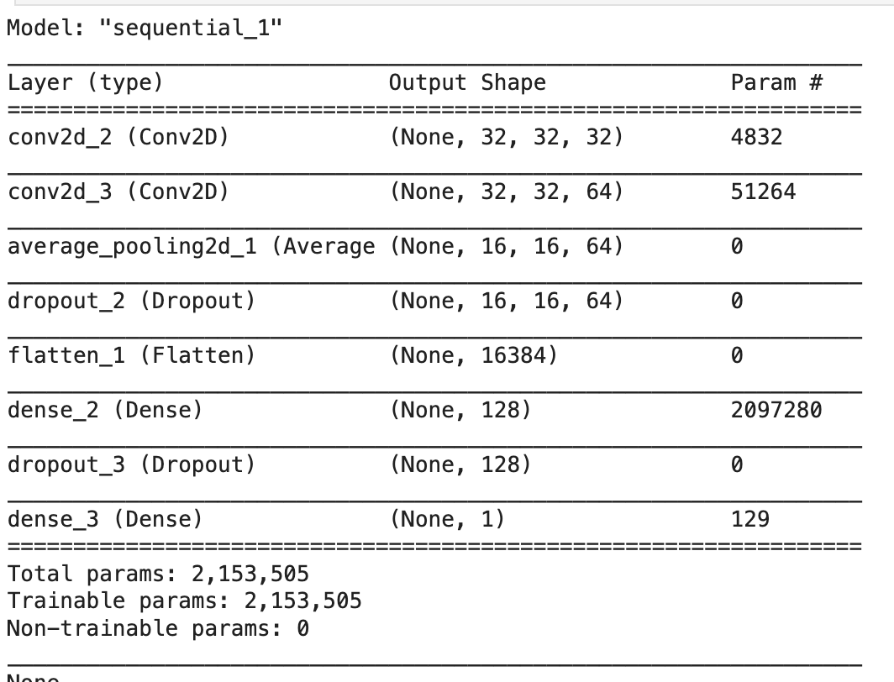
Classifying CNN: Model A 5*5 kernel size

Slide 14
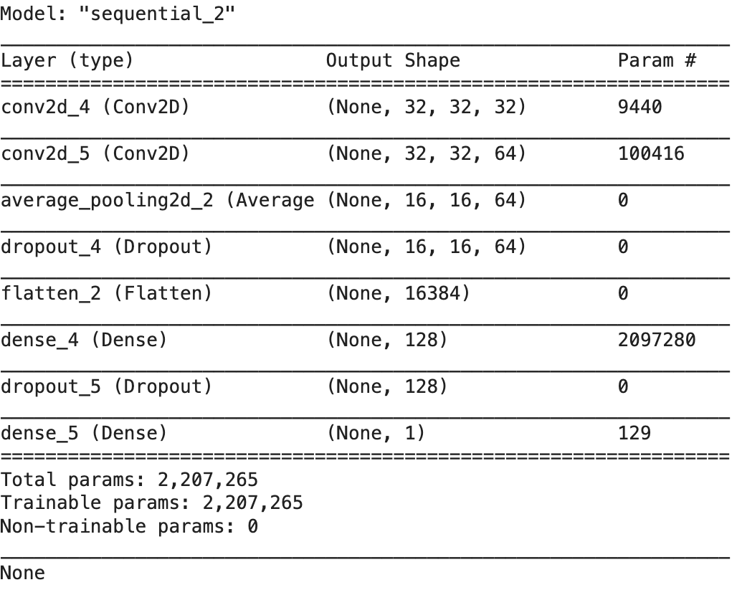
Model B: 7*7 Kernel

Slide 15
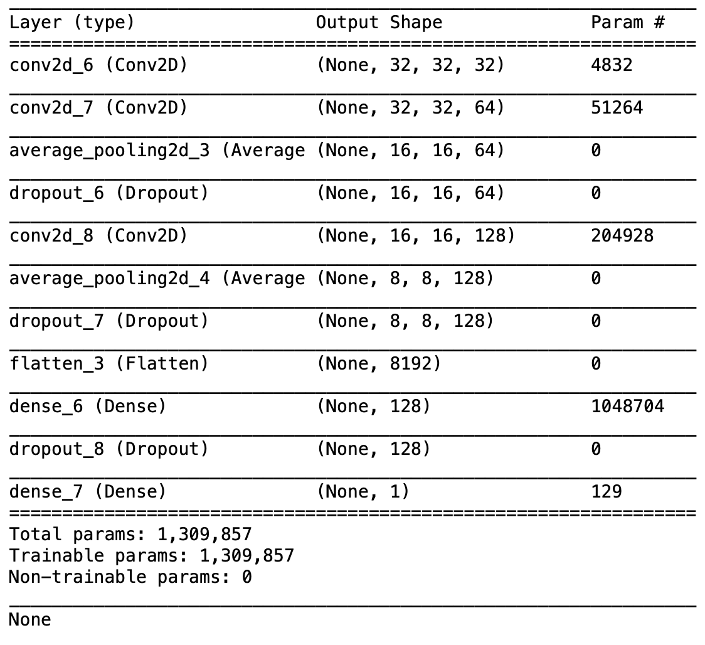
Model C: Complex model
Since model A have the best result so we built model C on top of model A

Slide 16
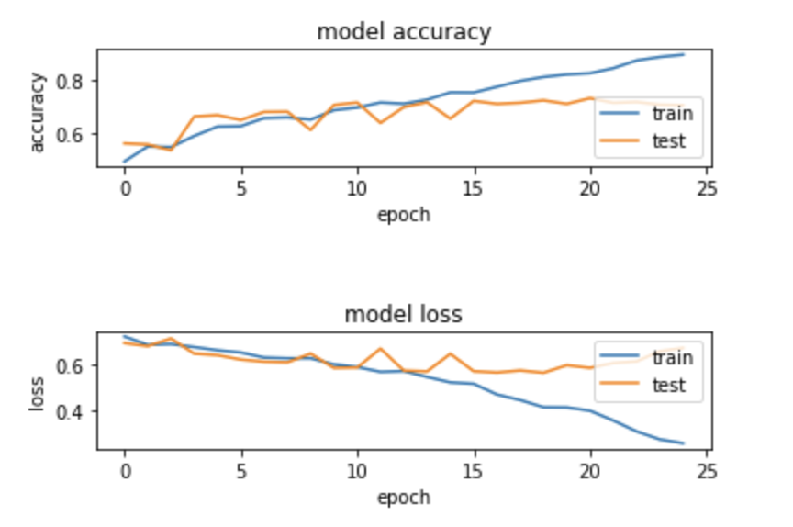
Result Analysis
Baseline model:
Baseline Test accuracy: 70.300001%

Slide 17
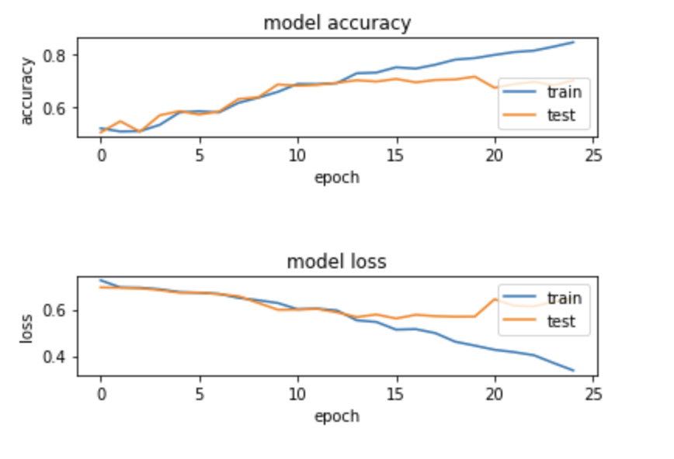
Result Analysis
Model A 5*5 kernel size
Model A Test accuracy: 69.999999%

Slide 18
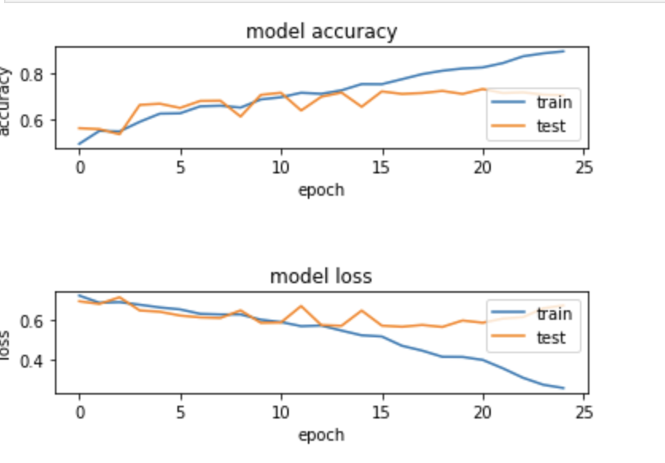
Result Analysis
Model B 7*7 kernel size
Model B Test accuracy: 70.4%

Slide 19
Result Analysis
Model C 5*5 kernel size
Model C Test accuracy: 72.799999%
Input
Conv1: 32 feature, 5*5 kernel size
Conv2: 64 feature, 5*5 kernel size
Pooling1: 2*2
Dropout1: 0.2
Conv3: 128 feature, 5*5 kernel size
Pooling2: 2*2
Dropout2: 0.2
FullConnect
Dropout3: 0.5
Output

Slide 20
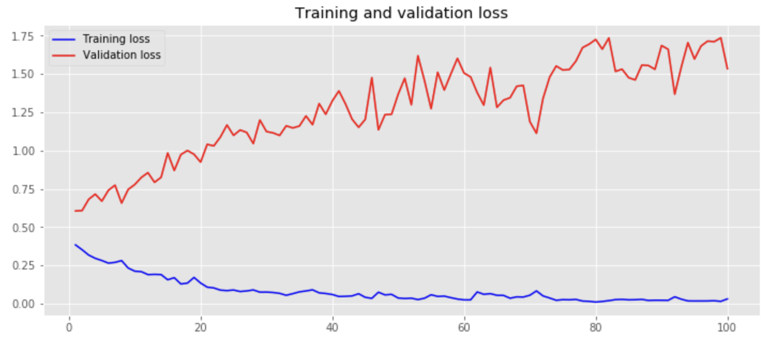
Conclusion And Next Steps: Steps
We experiment batch_size value: 32, 64, 128, 256 And we find, batch_size=128 is the best So we use callback function to find the best model on top of modelC

